Slide 1




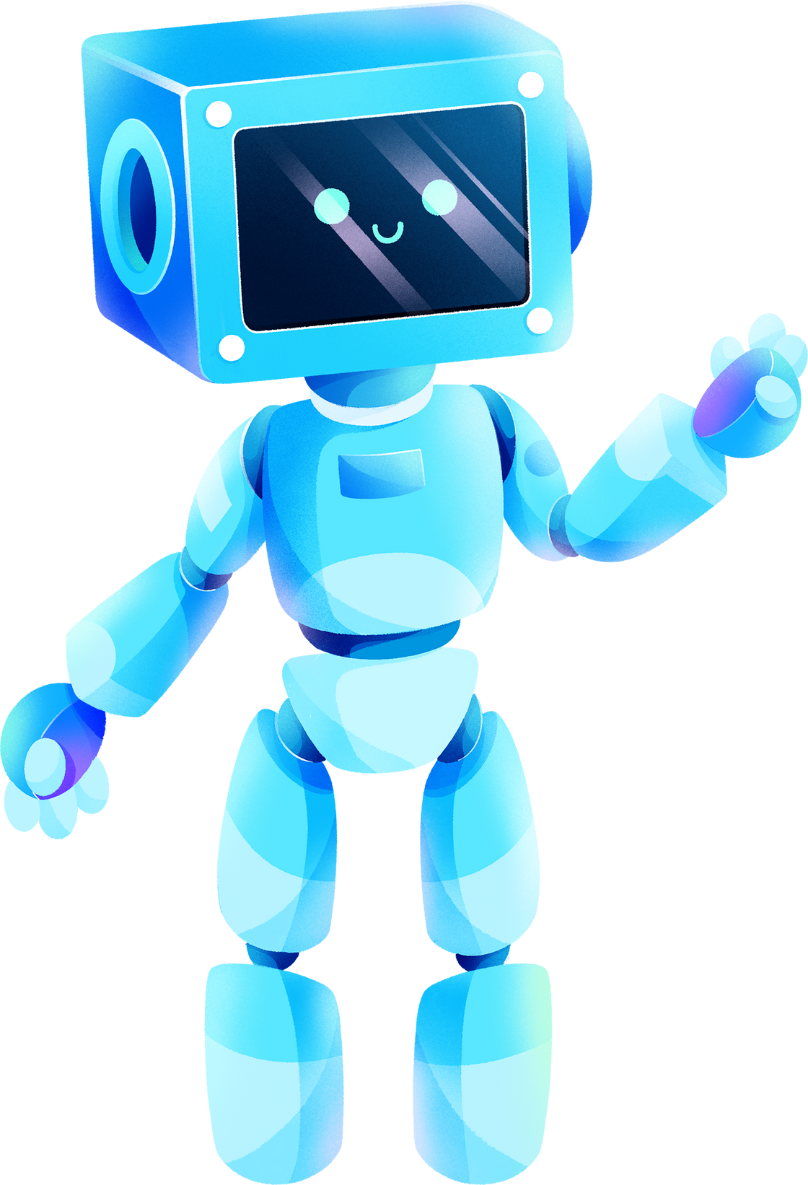

REPORT ON USE OF AI BY
GOOGLE
Presented By: Anik Roy (2115800003)
Arushi Gupta (2115800005)
Somil Gupta (2115800024)

Slide 2
TABLE OF CONTENTS
Introduction to Google
Technologies
Use of AI within Google
Comparative Analysis
Future Scope
Conclusion
01
02
03
04
05
06

Slide 3

INTRODUCTION
Google is a multinational technology company that specializes in internet-related products and services. It was founded in September 1998 by Larry Page and Sergey Brin while they were Ph.D. students at Stanford University.
What is Google known for?
Google is most famous for its search engine, which is one of the most widely used in the world. Google Search allows users to search for information on the internet using keywords and provides highly relevant search results.

Slide 4
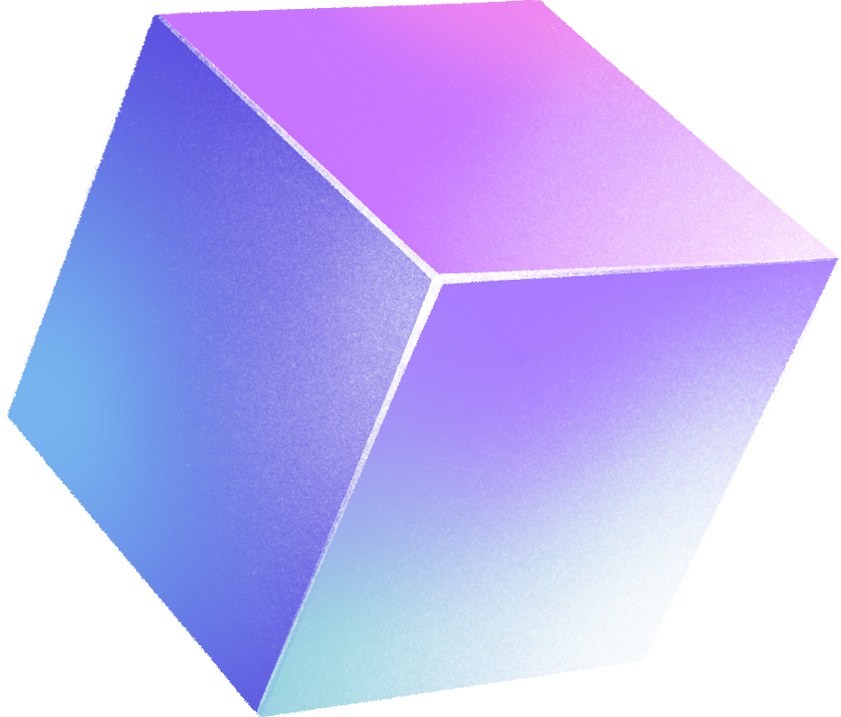
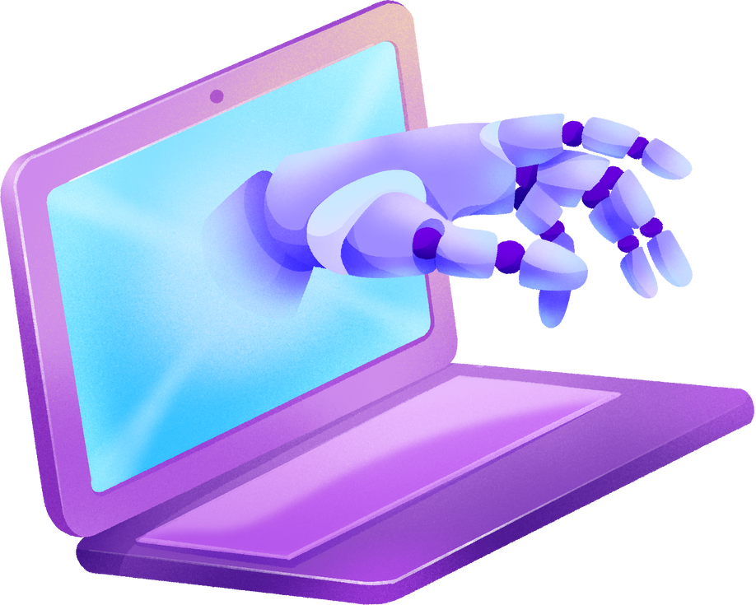
GOOGLE PRODUCTS USING AI
Search Engine
AI in Google Search enhances results by ranking, understanding natural language queries, predicting user intent, providing featured snippets, personalizing content, and detecting spam, resulting in more accurate, relevant, and personalized search outcomes.
Analytics
Google Analytics utilizes AI to analyze website and app data, delivering insights into user behavior and content performance, enabling data-driven decision-making and optimizing online experiences.

Slide 5
Assistant
Google News
Google Assistant leverages AI to understand voice commands, answer questions, control smart devices, and provide personalized assistance. It uses natural language processing and machine learning to enhance user interactions.
Google News uses AI to curate and personalize news content for users. It analyzes user preferences and behavior to deliver relevant news articles, improving the news consumption experience.
Google Lens
Tensorflow
Google Lens utilizes AI to analyze images and provide information about objects, text, and landmarks. It offers real-time recognition and augmented reality capabilities, enhancing visual search and information retrieval.
TensorFlow is an open-source AI framework by Google. It simplifies the development, training, and deployment of machine learning models, aiding the implementation of deep learning and neural networks.

Slide 6

SEARCH ENGINE
Rank Brain
Introduced in 2015, RankBrain is an AI algorithm that plays a crucial role in ranking search results. It utilizes a deep neural network to analyze the context of search queries and identify factors that indicate relevance, such as synonyms, related concepts, and user intent.
BERT
Bidirectional Encoder Representations from Transformers (BERT) is another AI-powered language model that enhances Google Search's understanding of natural language. It can better grasp the context of search terms, even if they are ambiguous or grammatically complex.

Slide 7
Neural Matching
Neural matching goes beyond keyword matching and utilizes neural networks to analyze the entire content of a webpage and the search query. This allows Google to identify deeper semantic connections and provide more relevant results.
Personalised Search
Google Search utilizes user data, such as search history, location, and browsing habits, to personalize search results. This helps tailor the search experience to individual needs and interests.
Image Context
Google's AI algorithms can analyze the content of images, allowing users to find relevant images when performing image searches.

Slide 8

GOOGLE ANALYTICS
Google Analytics is a web analytics service provided by Google that helps website owners and marketers track and analyze user interactions with their websites. It offers valuable insights into user behavior, traffic sources, conversion rates, and more. Google Analytics employs a variety of AI and machine learning techniques to provide data-driven insights to its users.

Slide 9

Google Analytics Features
Predictive Analytics: Google Analytics utilizes predictive analytics to forecast future user behavior. By analyzing historical data, machine learning models can predict user actions, such as conversion rates, bounce rates, and the likelihood of users completing specific goals.
Techniques Used: Regression, time series analysis, and predictive modelling, are used to analyze historical data and make predictions about future user behavior.
Anomaly Detection: Google Analytics identify unusual spikes or drops in website traffic, which could be due to technical issues, fraud, or external events. Identifying anomalies is crucial for taking timely action.
Techniques Used: Anomaly detection algorithms, include statistical methods and machine learning models like clustering or autoencoders, monitor website metrics for unusual changes.

Slide 10

Audience Segementation: AI and ML techniques are used to segment website visitors into different audience groups. This allows users to tailor their marketing efforts based on user characteristics and behaviours, ultimately optimizing their conversion strategies.
Techniques Used: Clustering algorithms and user profiling models segment website visitors based on attributes and behaviours.
Attribution modeling: It is a complex problem in digital marketing. Google Analytics assign proper credit to various touchpoints in the user journey. This assists marketers in understanding which marketing channels or campaigns are most effective in driving conversions.
Techniques Used: Machine learning techniques, such as Markov chains or data-driven attribution models, are applied to distribute credit to different touchpoints in a user's journey.

Slide 11
Google Analytics Comparative Analysis
Free Version: Google Analytics offers a robust free version, making it accessible to businesses of all sizes. This makes it an attractive option for smaller businesses and individuals with limited budgets.
User-Friendly Interface: Google Analytics provides an intuitive and user-friendly interface, which makes it easy for both beginners and experienced users to navigate and use effectively.
Integration with Google Services: It seamlessly integrates with other Google services like Google Ads, Google Search Console, and Google Data Studio, making it a powerful tool for tracking and optimizing digital marketing efforts.
Data Accuracy: Google Analytics is known for its accuracy and reliability in tracking website traffic and user behavior. It provides real-time data and comprehensive reports.

Slide 12

GOOGLE LENS
Google Lens is an image recognition technology developed by Google that uses AI, machine learning, and deep learning to interpret visual information from photos or camera input. It allows users to extract information, identify objects, and interact with the world around them by analyzing images. Google Lens is integrated into various Google products and mobile devices to provide a range of useful features.

Slide 13
GOOGLE LENS FEATURES
Image Recognition and Object Detection: Google Lens utilizes deep learning techniques, specifically convolutional neural networks (CNNs), to recognize and detect objects in images. This feature allows users to point their camera at objects, and Lens can identify them, providing information, similar images, and relevant links.
Text Recognition and Translation: Optical character recognition (OCR) technology, which incorporates machine learning algorithms, is used to recognize text within images. Google Lens can then translate this text into different languages, making it a valuable tool for travellers or language learners.
Landmark and Artwork Identification: Google Lens has the ability to recognize famous landmarks and artwork. This is accomplished by training deep learning models on extensive databases of landmarks and art pieces.

Slide 14
GOOGLE LENS COMPARATIVE ANALYSIS
Google's Search Engine Integration: Google Lens leverages Google's extensive search engine capabilities to provide accurate and relevant information about objects, landmarks, text, and more. This integration often results in more reliable search results.
Local Business Information: Google Lens can identify businesses and provide details such as contact information, opening hours, and user reviews, making it helpful for exploring local areas.
Shopping and E-commerce Integration: Google Lens can help users shop by identifying products and showing price comparisons and shopping options.
Math and Homework Help: Google Lens can solve math problems and provide step-by-step solutions, making it a valuable tool for students and educators.

Slide 15
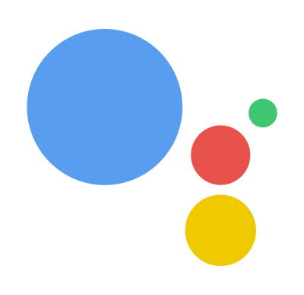
GOOGLE ASSISTANT
Google Assistant is a virtual assistant powered by artificial intelligence (AI) and machine learning (ML) technologies. It is available on various devices, including smartphones, smart speakers, and smart displays. Google Assistant is designed to provide users with voice-activated assistance, answer questions, perform tasks, and control smart home devices.

Slide 16
GOOGLE ASSISTANT FEATURES
Voice Recognition and Natural Language Processing (NLP): Google Assistant uses deep learning models for voice recognition and NLP to understand and interpret user voice commands. This enables users to have natural conversations with the assistant, making it responsive and user-friendly.
Techniques Used: Deep learning models, including convolutional neural networks (CNNs) and recurrent neural networks (RNNs), are used for voice recognition and NLP.
Contextual Understanding: ML algorithms in Google Assistant help it understand context. It remembers previous interactions, which allows users to have follow-up questions or commands without needing to repeat the context.
Techniques Used: This contextual understanding is achieved through recurrent neural networks (RNNs) and sequence-to-sequence models.

Slide 17
Recommendations and Predictive Suggestions: Google Assistant uses AI and ML to provide personalized recommendations and predictive suggestions based on user behavior and preferences. It learns from a user's interactions to offer relevant content, calendar reminders, or news updates.
Techniques Used: Collaborative filtering and recommendation systems, are used to analyze user behavior and provide recommendations.
Voice Synthesis: Deep learning techniques are used for voice synthesis. This enables Google Assistant to respond with natural-sounding and human-like voices.
Techniques Used: Voice synthesis is achieved using deep learning techniques like generative adversarial networks (GANs). These models generate natural-sounding voice responses by training on extensive voice data.

Slide 18
GOOGLE ASSISTANT COMPARATIVE ANALYSIS
Google's Search Expertise: Google Assistant leverages Google's powerful search engine and extensive knowledge graph, providing users with accurate and relevant information for a wide range of queries.
Third-Party Integrations: Google Assistant integrates with a wide range of third-party apps and services, allowing users to perform various tasks and control devices with voice commands.
Wide Platform Support: Google Assistant is available on a variety of devices and platforms, including smartphones, smart speakers, smart displays, and other smart home devices, offering a seamless and integrated experience.
Integration with Google Services: Google Assistant seamlessly integrates with other Google services like Google Calendar, Gmail, Google Photos, and more, making it a powerful tool for managing your digital life.

Slide 19

GOOGLE NEWS
Google News is a web-based news aggregator and app that provides users with personalized news content from various sources around the world. The platform uses a wide array of AI and machine learning techniques to deliver relevant, up-to-date, and personalized news to its users.

Slide 20
GOOGLE NEWS FEATURES
Personalized Recommendations: Google News uses machine learning algorithms to provide users with personalized news recommendations.
Techniques Used: Machine learning models, such as collaborative filtering and content-based recommendation systems, analyze a user's past reading behavior and preferences.
Topic Clustering and Organization: Google News can understand the content of articles and group them together under relevant headings.
Techniques Used: Natural Language Processing techniques, including text classification and clustering algorithms, are used to understand the content of news articles.

Slide 21
Sentiment Analysis: Sentiment analysis helps to assess the tone and sentiment of news articles.
Techniques Used: Sentiment analysis models employ NLP and machine learning to determine the sentiment expressed in articles. This involves classifying text as positive, negative, or neutral, enabling a balanced mix of news content to users.
Language Translation: Google News is available in multiple languages, and it provides news content in different languages. This feature enables users to access news from around the world.
Techniques Used: Google News uses machine translation models, such as neural machine translation, to provide news articles in multiple languages.

Slide 22
COMPARING GOOGLE NEWS COMPARATIVE ANALYSIS
Personalized News: Google News uses machine learning and algorithms to provide personalized news recommendations based on your interests and reading habits. This helps you discover news articles that are more relevant to you.
Diverse Sources: Google News pulls news articles from a wide range of sources, including major news outlets, smaller publications, and local sources, giving you a diverse and balanced perspective on current events.
Real-Time Updates: Google News provides real-time updates, ensuring you stay informed about the latest developments as they happen.
Local News: It offers local news coverage based on your location, allowing you to stay up-to-date with events in your community.

Slide 23
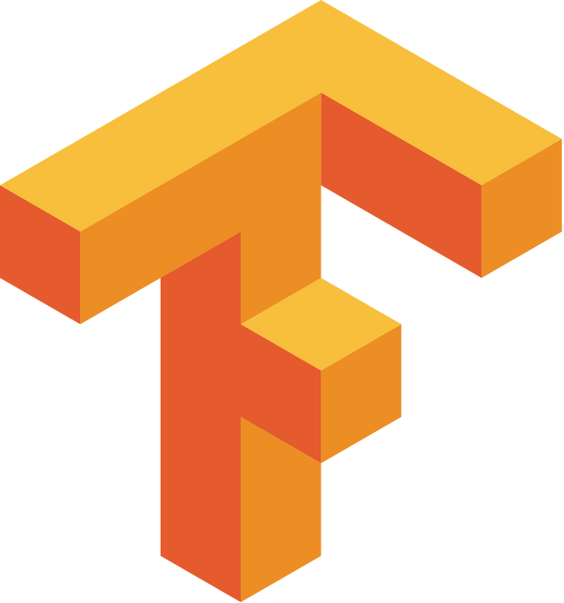


TENSORFLOW
TensorFlow is an open-source software library for machine learning and artificial intelligence. It can be used across a range of tasks, from building simple linear models to training deep neural networks. TensorFlow is widely used by researchers and developers in the field of machine learning, and it is one of the most popular libraries for building AI applications.

Slide 24
AI/ML implementation using TensorFlow
Building and training machine learning models: TensorFlow provides a high-level API that makes it easy to build and train machine learning models. The API is designed to be flexible and expressive, so it can be used to build a wide variety of models, including linear models, logistic regression models, and deep neural networks.
Deploying machine learning models: TensorFlow can be used to deploy machine learning models to production. The library provides a number of tools that make it easy to deploy models to a variety of platforms, including CPUs, GPUs, and cloud platforms.
Developing new AI algorithms: TensorFlow can be used to develop new AI algorithms. The library provides a number of tools that make it easy to experiment with new algorithms and to share them with others.

Slide 25
Here are some of the ways that TensorFlow is better than the competition:
Flexibility: TensorFlow is a very flexible library that can be used to build a wide variety of machine learning models. The library's API is designed to be easy to use, so it can be used by developers of all levels of experience.
Performance: TensorFlow is a very performant library that can be used to train and deploy machine learning models on a variety of platforms. The library is optimized for performance, so it can be used to train and deploy models that are both accurate and efficient.
Community: TensorFlow has a large and active community of users and developers. This community is a great resource for finding help and support, and it is also a great place to learn about new developments in the field of machine learning.

Slide 26

GOOGLE BARD

Slide 27

WHAT IS PALM?
PaLM (Pathway Language Model) is a 540-billion parameter dense decoder-only Transformer model developed by Google AI. It is one of the largest and most powerful language models ever created, and it has demonstrated impressive results on a variety of tasks, including natural language understanding, machine translation, and code generation.
PaLM was trained on a massive dataset of text and code, and it is able to generate realistic and coherent text, translate languages accurately, and write different kinds of creative content. It can also answer your questions in an informative way, even if they are open ended, challenging, or strange.
PaLM is still under development, but it has already been used to create a number of impressive applications. For example, it has been used to generate realistic dialogue for chatbots, translate news articles into different languages, and write creative text formats like poems, code, scripts, musical pieces, email, letters, etc.
PaLM is a powerful tool that has the potential to revolutionize the way we interact with computers. It is still under development, but it has already shown great promise in a variety of applications.

Slide 28
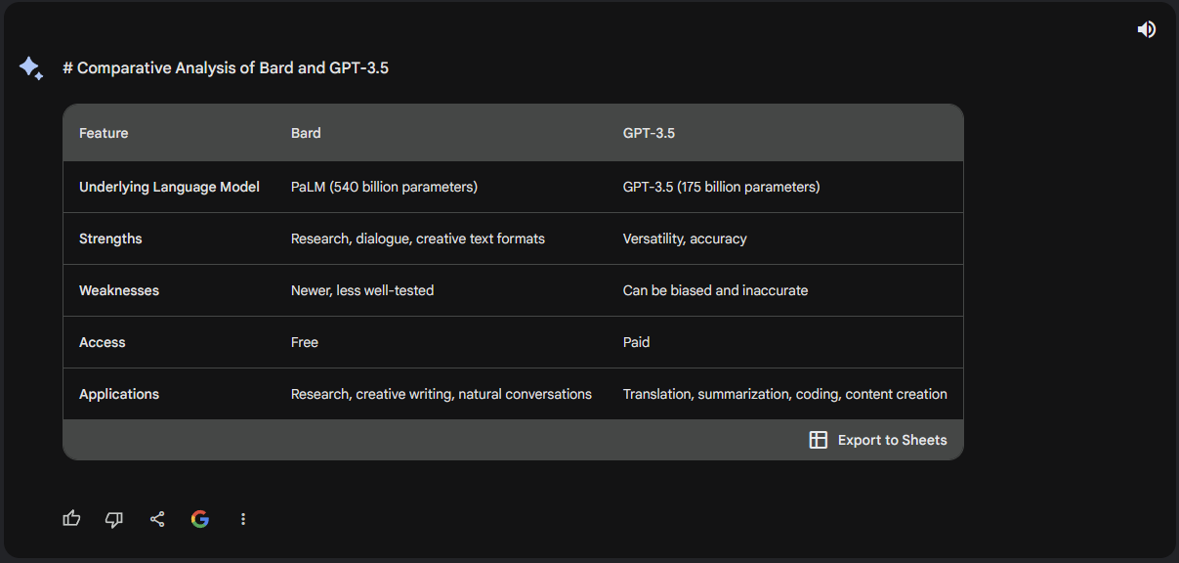

Slide 29
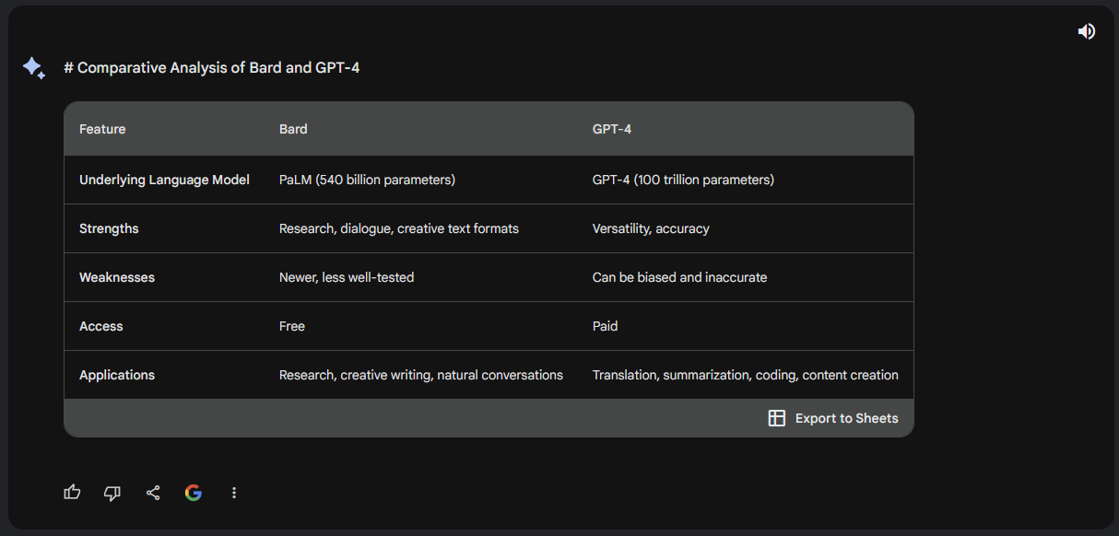

Slide 30
FUTURE SCOPE OF AI IN GOOGLE
Improving Language Understanding and Processing
Personalizing User Experiences
Augmenting Human Productivity
Expanding Cloud-based AI Services
Advancing Research and Innovation

Slide 31
CONCLUSION
AI and ML have transformed Google's products and services in various ways.
Google is continuously investing in AI and ML research and development.
AI and ML are enhancing search capabilities, personalizing user experiences, and augmenting human productivity.
Google is expanding its cloud-based AI services and exploring new applications of these technologies.
Google is committed to using AI and ML to solve real-world problems and shape the future of technology.

Slide 32
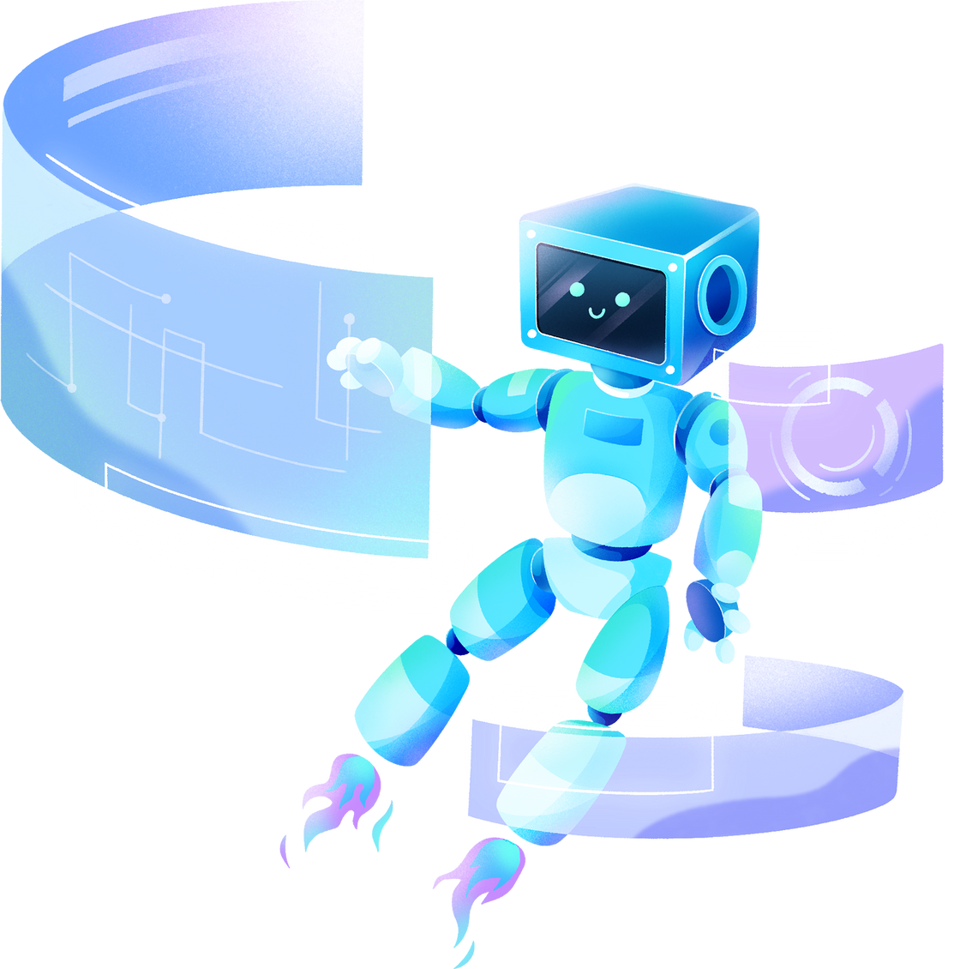
THANK YOU!

